Slide 1
Process Control
Jun Xu
CS-392 Systems Programming
Spring 2019

Slide 2
Question at Beginning
How does shell run a command?

Slide 3
Creating New Processes
pid_t fork();
Create a child process
The child is copy of the parent (calling) process
Both the parent and child resume execution in the instruction following fork()
But a different value is returned in each case
0 -> in the child process
Child PID -> in the parent process

Slide 4
int main()
{
pid_t pid;
int w = 100;
if ((pid = fork()) < 0) {
perror("fork");
return -1;
} else if (pid == 0) {
/* child */
w = 200;
} else {
/* parent */
w = -100;
}
printf("I am %d, child of %d, w = %d\n", getpid(), getppid(), w);
return 0;
}

Slide 5
fork

Slide 6
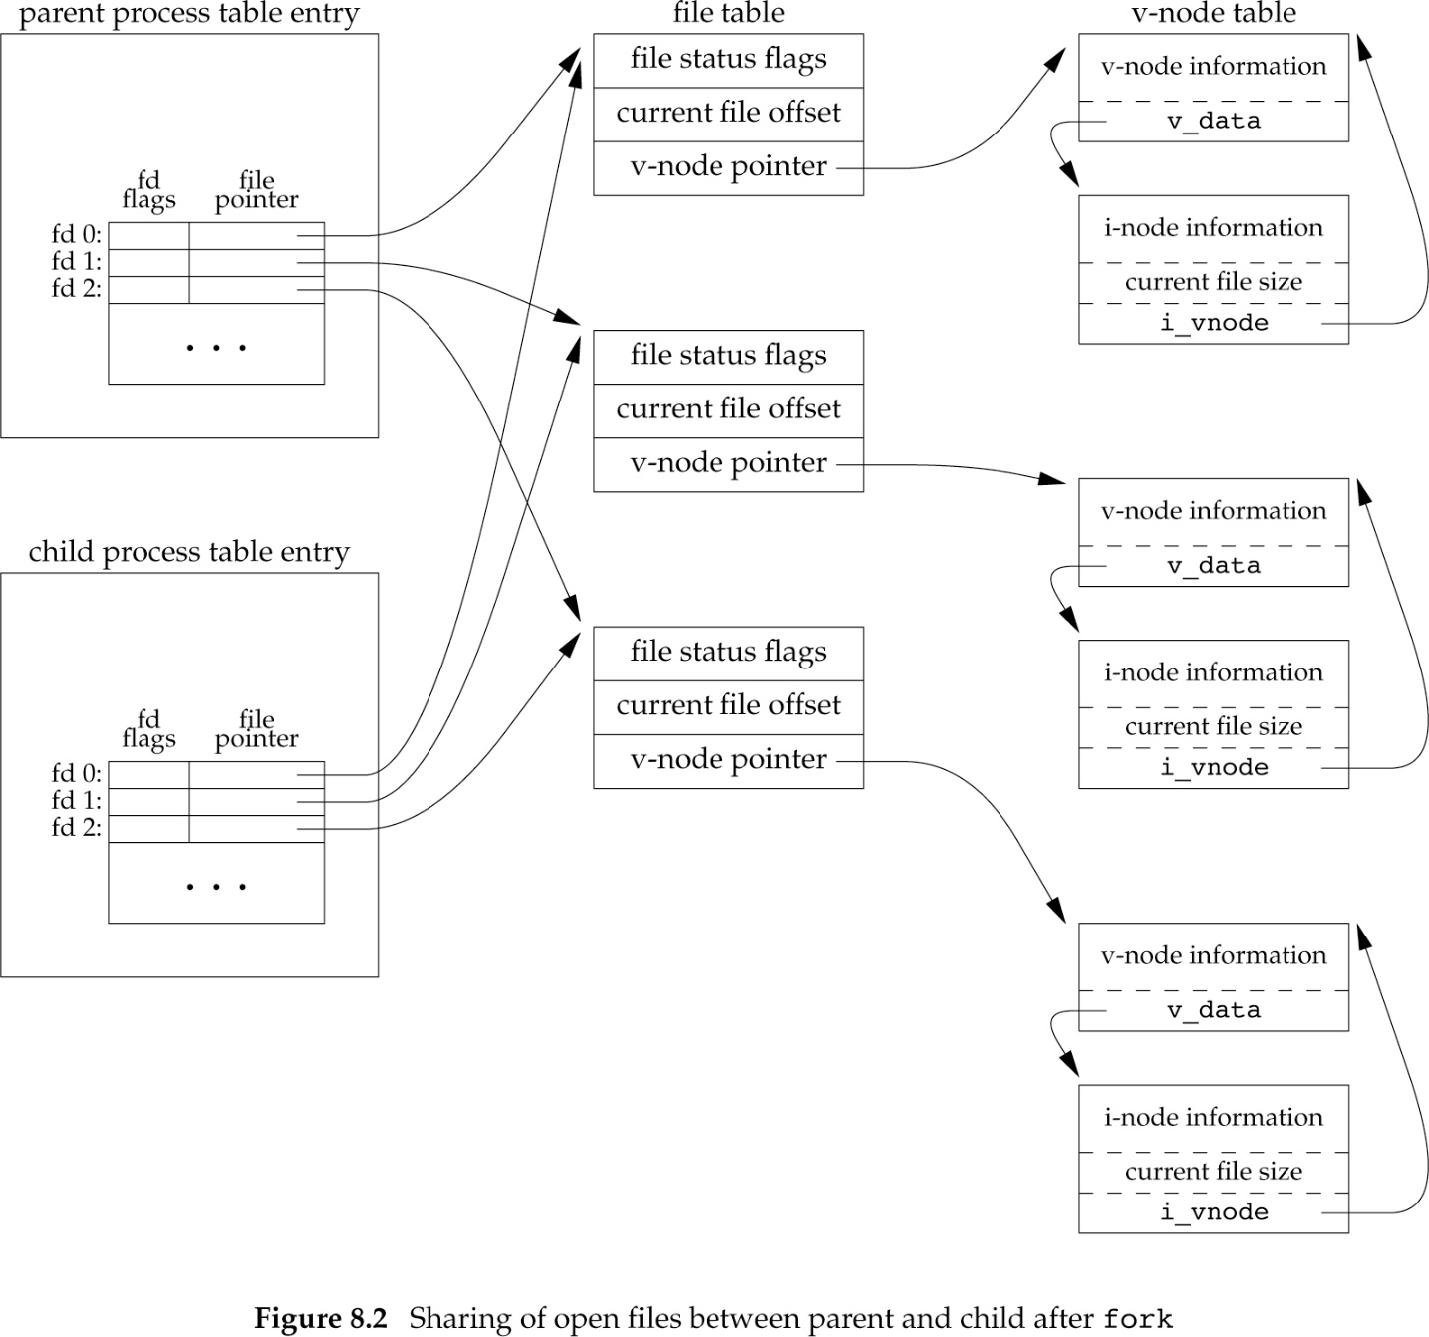
File Sharing
The child process inherits the all the file descriptors of its parent

Slide 7
Waiting for Children
pid_t wait(int *status);
Wait for the status of a child process to change
For example, the child terminated, was stopped, etc.
Return the pid of the child
status contains information on the state change

Slide 8
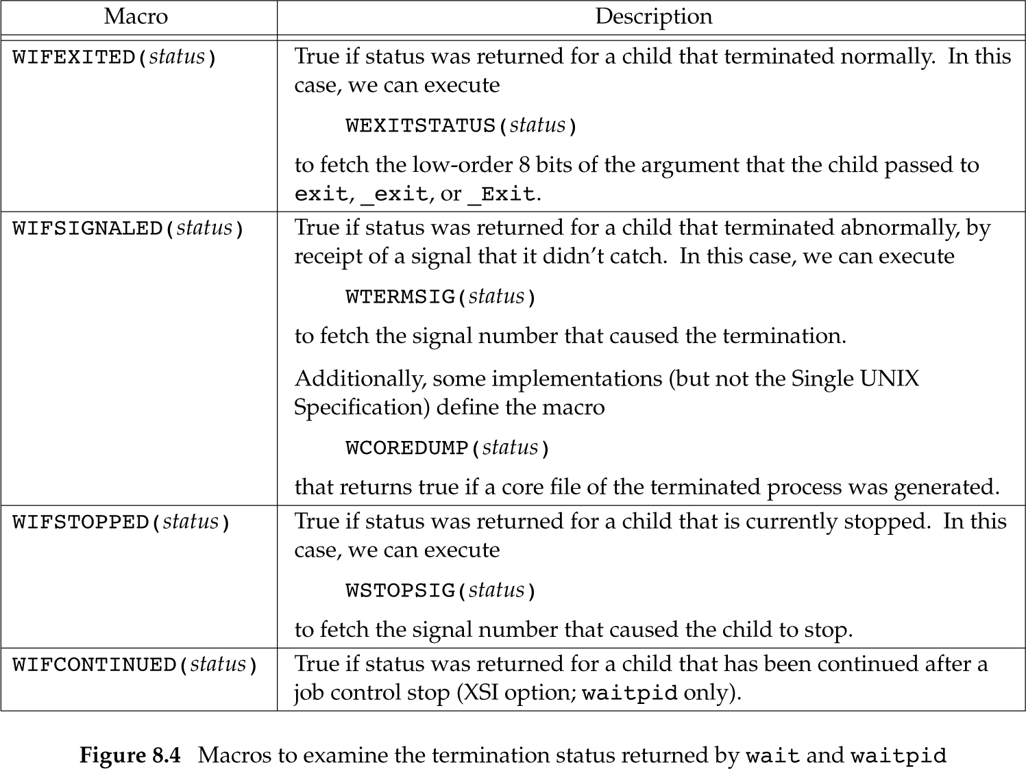

Slide 9
Zombie Processes
A zombie process or defunct process is a process that has completed execution but still has an entry in the process table
This occurs when child processes exit but the parent has yet to read the exit status via wait.
Once the exit status is read via the wait system call, the zombie's entry is removed from the process table and it is said to be "reaped".
A child process always first becomes a zombie before being removed from the resource table.
Processes that stay zombies for a long time are generally an error and cause a resource leak.

Slide 10
Zombie Processes
Always wait for your children!

Slide 11
Orphan Processes
An orphan process is a computer process whose parent process has finished or terminated, though it remains running itself.

Slide 12
exec
The exec() family of functions replaces the current process image with a new process image.

Slide 13
Exec Functions
int execl(const char *pathname, const char *arg0, ... /* (char *)0 */ );
int execv(const char *pathname, char *const argv []);
int execle(const char *pathname, const char *arg0, ... /* (char *)0, char *const envp[] */ );
int execve(const char *pathname, char *const argv[], char *const envp []);
int execlp(const char *filename, const char *arg0, ... /* (char *)0 */ );
int execvp(const char *filename, char *const argv []);

Slide 14
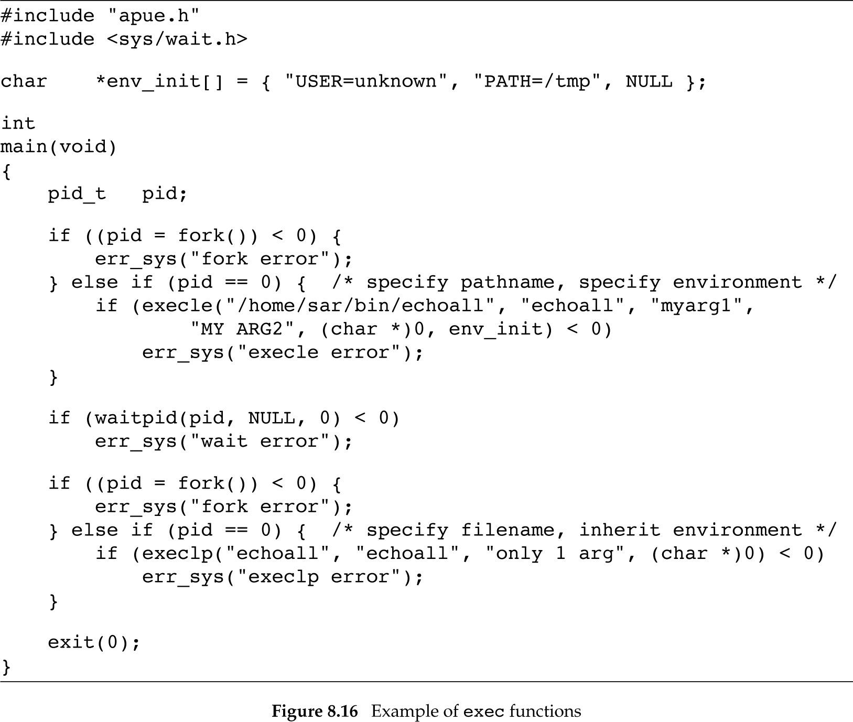

Slide 15
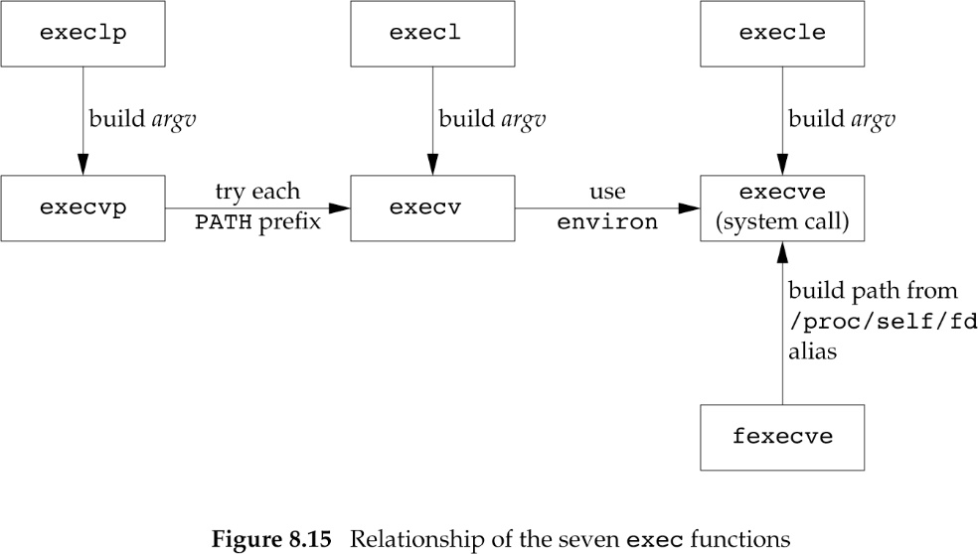

Slide 16
System Function
int system(const char *command);
Execute the shell command and return
Fork and invoke execl("/bin/sh", "sh", "-c", command, (char *) 0);

